Slide 1

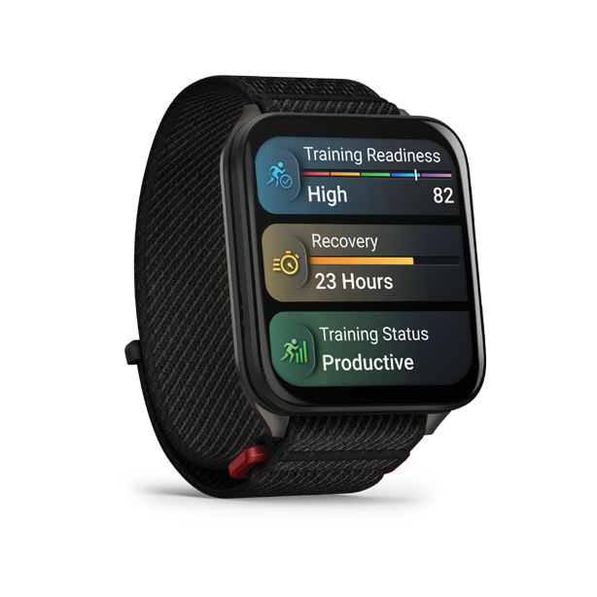
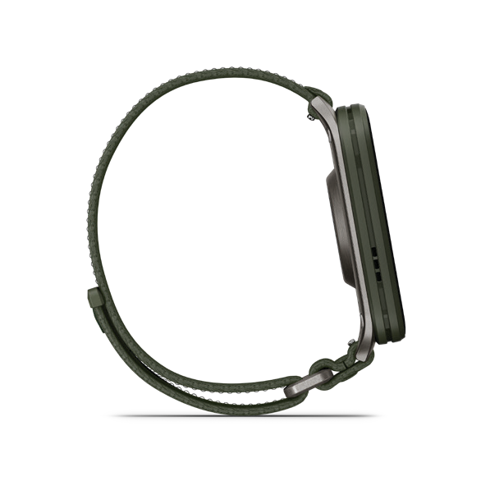
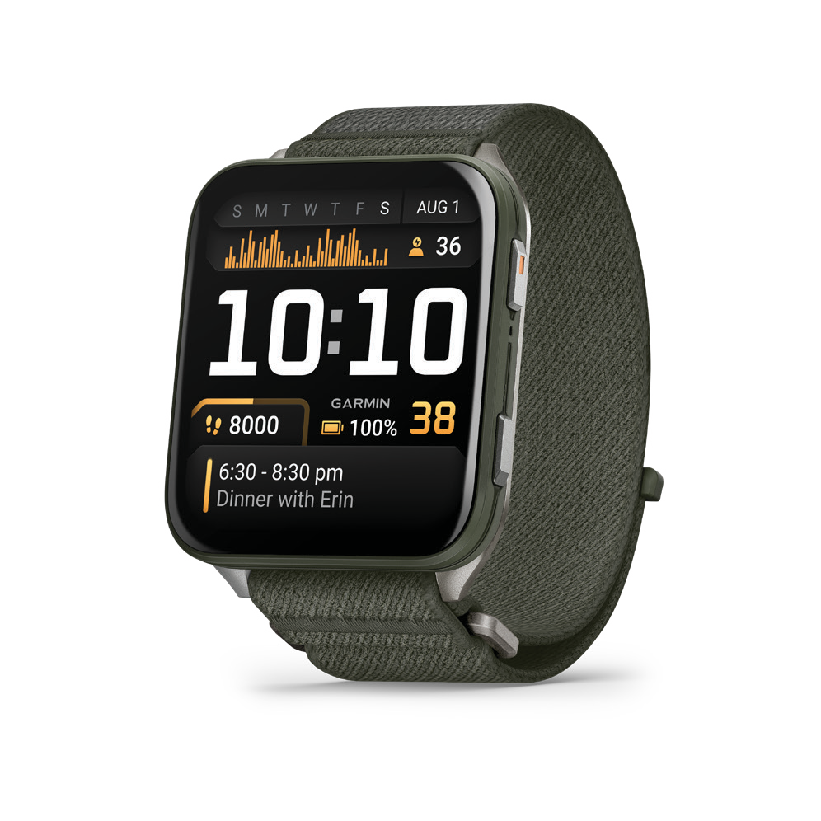
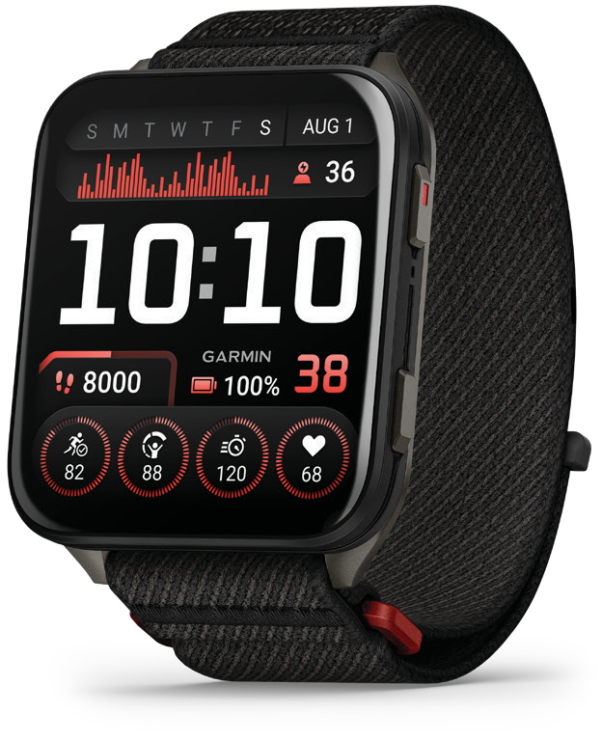
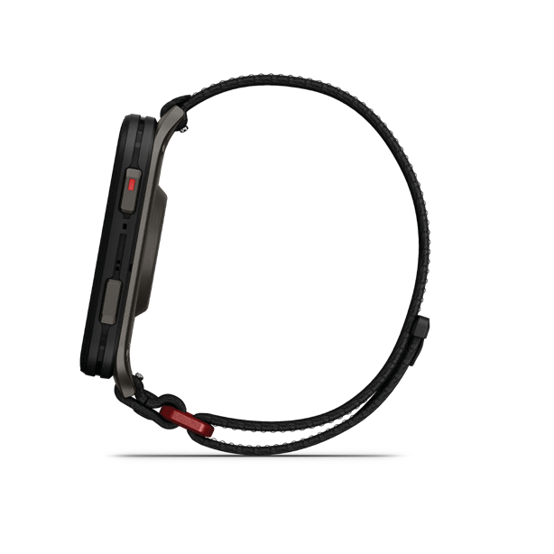
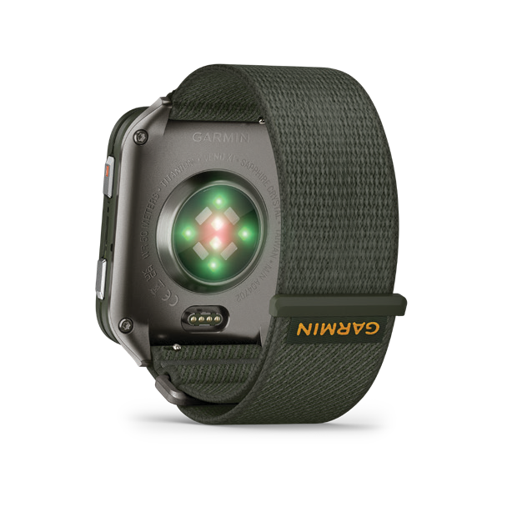

VENU® X1
PREMIUM GPS SMARTWATCH
NEW PRODUCT ANNOUNCEMENT
June 12, 2025
PRODUCT OVERVIEW
The Venu® X1 GPS smartwatch features our biggest display — 2” easy-to-read AMOLED — and our thinnest watch case measuring 8 mm. It also has a sapphire lens and bright LED flashlight. Wear it all day, every day, thanks to the sleek and lightweight design, up to 8 days of battery life in smartwatch mode and ComfortFit nylon band. Optimise your health with HRV status, advanced sleep monitoring and Body Battery™ energy monitoring¹. Track your passions with more than 100 preloaded sports apps, including running, golf and strength training. Train for an event, achieve a milestone, or improve your fitness with Garmin Coach training plans for running, cycling or strength. Train smarter and maximise your performance with the training readiness score, training status and endurance score, and be prepared for whatever the day brings¹. Stay connected and take calls from your wrist with a built-in speaker and microphone² when your watch is paired to your smartphone. Onboard TopoActive maps and 43,000+ preloaded golf courses allow you to navigate on the trail, the city or the course.

Slide 2
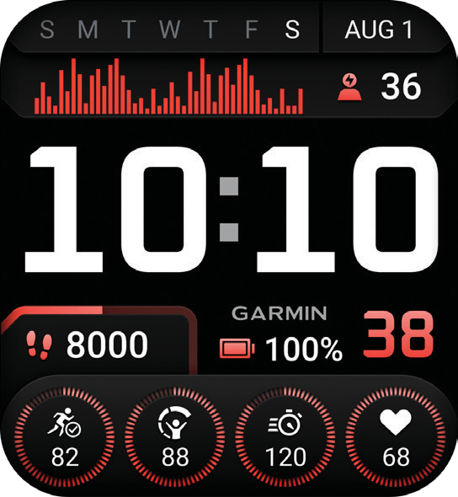
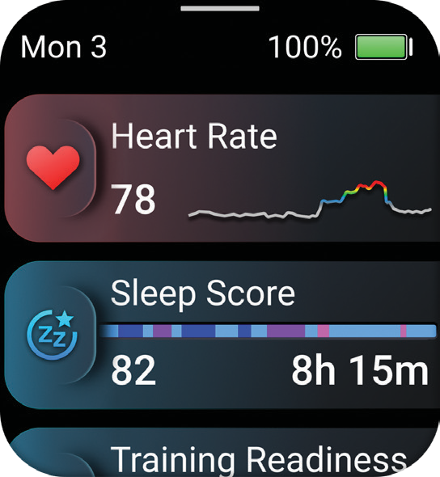
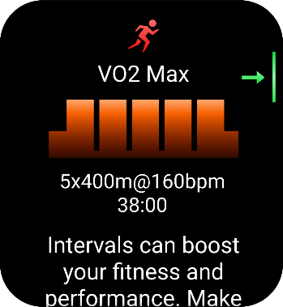
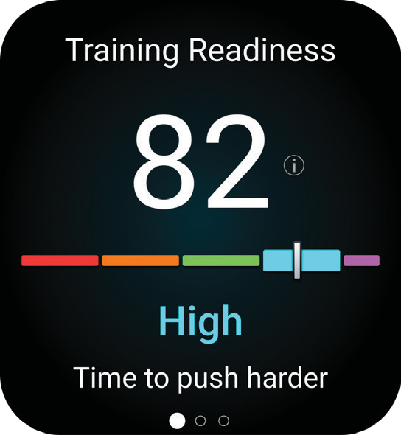
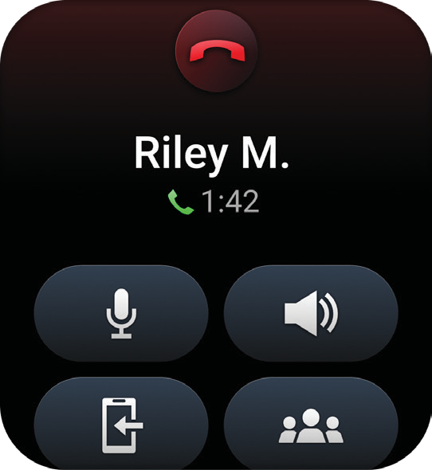
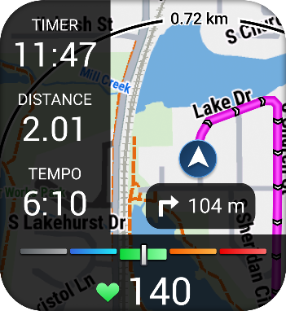
NEW PRODUCT ANNOUNCEMENT
June 12, 2025
VENU® X1
PREMIUM GPS SMARTWATCH
KEY FEATURES
EASY-TO-READY DISPLAY
HEALTH IS WEALTH
See your data on our biggest 2-inch MOLED display with a scratch-resistant sapphire lens. Enjoy all-day wearability, thanks to the lightweight titanium case back, sleek design and ComfortFit nylon band.
Learn more about your body and make improvements toward a healthier lifestyle with 24/7 health and wellness monitoring with HRV status, advanced sleep tracking, Body Battery™ energy monitoring, Pulse Ox and more³. See your stats in the morning report, and get a customisable overview of your sleep, training outlook, HRV status and more.
WORKOUT OPTIONS
PERFORMANCE AND TRAINING FEATURES
Track all the ways you move with 100+ preloaded sports apps, including running, golf, strength training and more. Plus, Garmin Coach plans for running, strength and cycling help you prepare for whatever your goals might be.
Advanced performance features
such as training readiness help you know when it’s time to push your workout or take a recovery day. Track your performance progress with features that include endurance score, training status and hill score — and see how your body is adapting to your training load, so you know if you’re training productively.
EVERYDAY UTILITY
ADVANCED MAPPING
A built-in LED flashlight provides convenient illumination when you need it. Make and take phone calls from your wrist when your watch is paired to your smartphone. You can even control watch functions with voice commands — or use your smartphone’s voice assistant to respond to text messages and more.
Easily navigate during select activities with preloaded TopoActive maps from around the world. Improve your game with advanced golf features and preloaded CourseView maps for more than 43,000 golf courses around the world.

Slide 3
VENU® X1
PREMIUM GPS SMARTWATCH
NEW PRODUCT ANNOUNCEMENT
June 12, 2025
KEY FEATURES
BATTERY PERFORMANCE | Up to 8 days in smartwatch mode; up to 16 hours in GPS mode.
BODY BATTERY ENERGY MONITORING | Track your body’s energy levels to find the best times for activity and rest³.
HRV STATUS | Gain a deeper understanding of your overall health, stress and recovery through heart rate variability while you sleep.
MORNING REPORT | Get a customisable overview of your sleep, training outlook, HRV status, weather and more as soon as you wake up.
TRAINING READINESS | From the moment you wake up, get a readiness score based on your sleep quality¹, recovery, training load and more, so you can determine if it’s a good day to go hard — or take it easy.
TRAINING STATUS | Get insight, and know whether you’re training productively, peaking or strained.
GARMIN COACH | Prepare for your next race, train for a milestone, or simply improve your fitness with Garmin Coach adaptive or prebuilt running, cycling or strength training plans. For more personalised workouts, select plans even adapt based on your performance and health metrics.
GOLF | See distance to the front, middle and back of the green, layups and hazards, and get preloaded full-colour CourseView maps for 43,000+ courses around the world.
DYNAMIC ROUND TRIP ROUTING | Enter how far you want to go and get suggested routes that will bring you back. If you break off course, your watch will map a new one that hits the same mileage.
WATCH FACE EDITOR | Choose from several different watch faces with customisable data to make your watch the way you want it. Find additional watches in the Connect IQ Store or create your own with the Face It® feature.
CALCULATOR NEW | The easy-to-use calculator app includes a tip calculator for quick needs.
MUSIC AND GARMIN PAY™ CONTACTLESS PAYMENTS | Live connected with smart notifications², music storage, Garmin Pay contactless payments⁵ and more.
VOICE COMMANDS | Voice command feature lets you access select watch controls even without a smartphone connection.
GARMIN CONNECT™ APP | See your health and fitness information, connect with friends, and more.
ON-WRIST TEXTING | Use the keyboard to send quick text responses on your paired watch (Android only or through the Garmin Messenger™ app⁶) so you can keep your phone in your pocket.

Slide 4
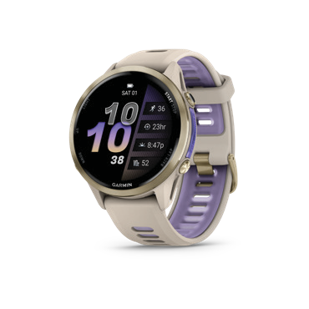
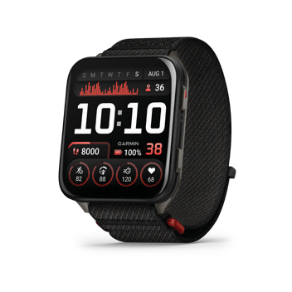
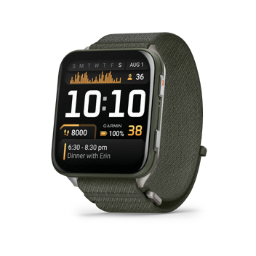
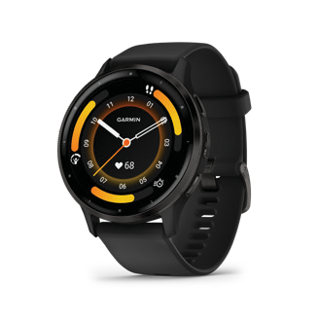
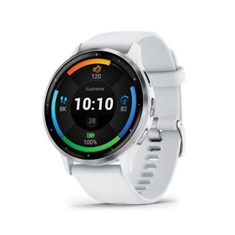
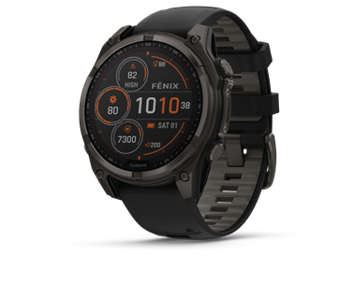
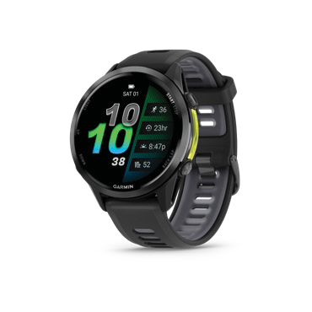
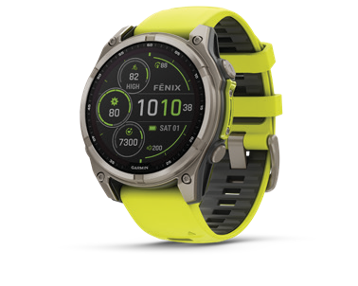
VENU® X1
PREMIUM GPS SMARTWATCH
NEW PRODUCT ANNOUNCEMENT
June 12, 2025
PRODUCT COMPARISON
 | VENU X1 | VENU® 3 | FENIX® 8 | FORERUNNER® 970
WELLNESS FEATURES
BODY BATTERY™ ENERGY MONITORING | • | • | • | •
PULSE OX SENSOR² | • | • | • | •
WRIST-BASED HEART RATE | • | • | • | •
RESPIRATION TRACKING | • | • | • | •
HYDRATION TRACKING | • | • | • | •
WOMEN’S HEALTH TRACKING | • | • | • | •
ALL-DAY STRESS TRACKING | • | • | • | •
SLEEP SCORE | • | • | • | •
MORNING REPORT | • | • | • | •
EVENING REPORT |  |  | • | •
HEART RATE VARIABILITY (HRV) | • | • | • | •
HEALTH SNAPSHOT™ FEATURE | • | • | • | •
NAP DETECTION | • | • | • | •
ECG APP |  | • | • | •
FITNESS FEATURES
VO2 MAX | • | • | • | •
FITNESS AGE | • | • | • | •
BUILT-IN GPS | • | • | • | •
FLOORS CLIMBED | • | • | • | •
GOLF FEATURES | (Premium) | • | (Premium) | •
SPORTS APPS | 100+ | 30+ | 90+ | 30+
GARMIN COACH | • | • | • | •
GARMIN RUN/CYCLE COACH | • |  | • | •
ON-SCREEN WORKOUT ANIMATIONS | • | • | • | •
TRAINING STATUS | • | • | • | •
TRAINING READINESS | • | • | • | •
MULTISPORT/TRIATHLON | • |  | • | •
RUNNING DYNAMICS | • | • | • | •
RUNNING POWER | • | • | • | •
PACE PRO PACING STRATEGIES | • | • | • | •
DAILY SUGGESTED WORKOUT | • | (Run) | • | •
MOBILITY ACTIVITY PROFILE | • |  | • | •
DIVE FEATURES |  |  | •
SAFETY AND TRACKING⁴
INCIDENT DETECTION | • | • | • | •
ASSISTANCE | • | • | • | •
CONNECTED FEATURES²
PHONES CALLS | • | • | • | •
SMART NOTIFICATIONS² | • | • | • | •
ON-WRIST TEXTING⁶ | • | • | • | •
GARMIN PAY™ CONTACTLESS PAYMENTS⁴ | • | • | • | •
VOICE COMMANDS | • |  | • | •
SPECS/HARDWARE
MULTIBAND GPS |  |  | • | •
CASE MATERIAL | Titanium caseback | Stainless Steel | Stainless Steel/Titanium | Titanium
FLASHLIGHT | • |  | • | •
DISPLAY TYPE | AMOLED | AMOLED | MIP/AMOLED | AMOLED
DISPLAY RESOLUTION (PIXELS) | 448 x 486 | 454 x 454 | 454 x 454 | 454 x 454
DISPLAY SIZE | 2.0” (50.8 mm) | 1.4” (35.4 mm) | 1.4” (35.4 mm) | 1.4” (35.4 mm)
BATTERY LIFE | Up to 8 days | Up to 14 days | Up to 16 days | Up to 15 days
CASE WIDTH | 41.2 mm | 45.0 mm | 47.0 mm | 47.0 mm
CASE HEIGHT | 7.9 mm | 12.0 mm | 15.5 mm | 13.0 mm
WEIGHT | 34 g | (Nylon band); 40 g (ComfortFit band) | 47 g | 80 g (Stainless); 73 g (Titanium) | 56 g
OTHER
CALCULATOR | •
BUILT-IN MAPPING | • |  | • | •

Slide 5


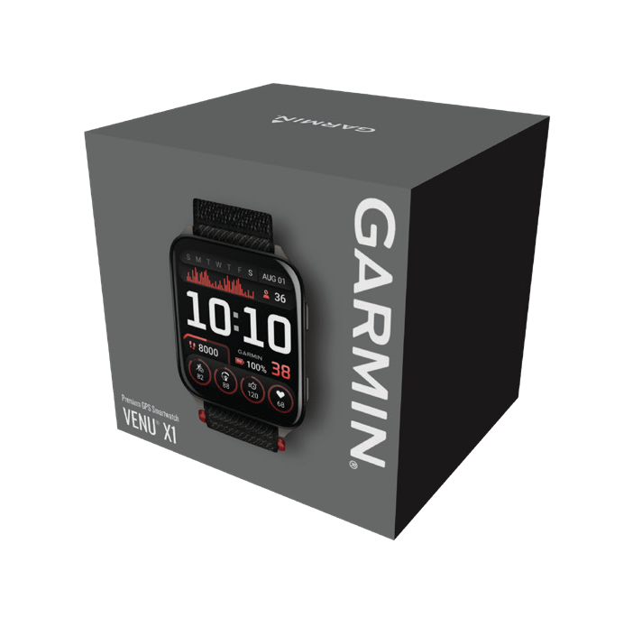
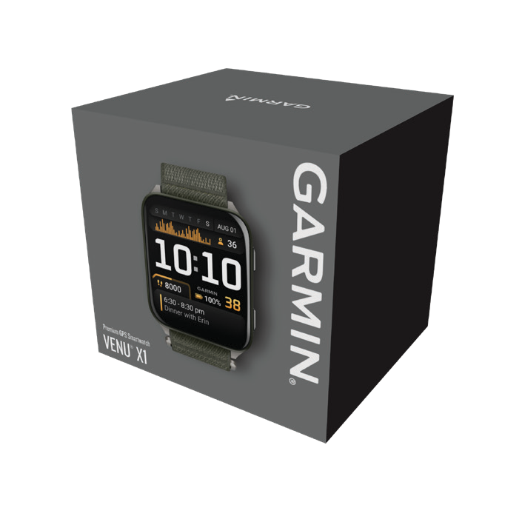
VENU® X1
PREMIUM GPS SMARTWATCH
NEW PRODUCT ANNOUNCEMENT
June 12, 2025
PRODUCT CONFIGURATIONS
HTS: 8517620000
VENU X1
INCLUDES | COUNTRY OF ORIGIN
Venu X1, charging/data cable, documentation | Made in Taiwan. Cable made in Taiwan, Myanmar or China.
DESCRIPTION | SKU | UPC | RRP | TYPE OF DISTRIBUTION | MARKETPLACE BAN
Black with Slate Titanium Caseback and Black ComfortFit Nylon Band | 010-02980-02 | 753759342760 | €799.99 | Exclusive | Yes
INCLUDES | COUNTRY OF ORIGIN
Venu X1, charging/data cable, documentation | Made in Taiwan. Cable made in Taiwan, Myanmar or China.
DESCRIPTION | SKU | UPC | RRP | TYPE OF DISTRIBUTION | MARKETPLACE BAN
Moss with Titanium Caseback and Moss ComfortFit Nylon Band | 010-02980-03 | 753759342777 | €799.99 | Exclusive | Yes
PHYSICAL SPECIFICATIONS
 | VENU X1
Case Dimensions | 41.1 x 46.3 x 7.9 mm
Weight | 34 g | with nylon band; 40 g with ComfortFit band
Band width | 24 mm
PACKAGING SPECIFICATIONS
Gift box dimensions (W x H x D) | 3.6” x 3.4” x 3.2” (92 x 86 x 81 mm)
Gift box weight | 5.5 oz. (156 g)
Master carton dimensions (W x H x D) | 13.6 x 15.5” x 11.7” (34.5 x 39.4 x 29.7 cm)
Master carton weight | 17.8 lbs (8.1 kg)
Master carton quantity | 48

Slide 6
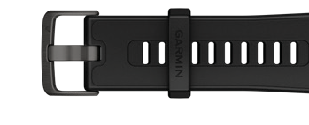
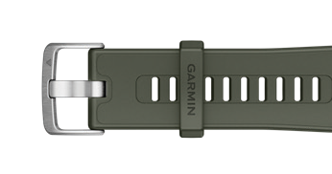
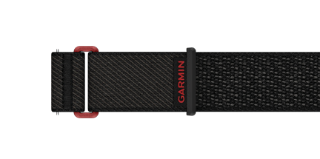
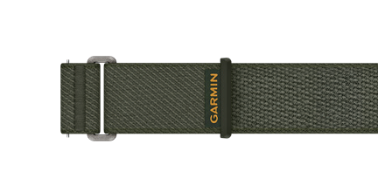
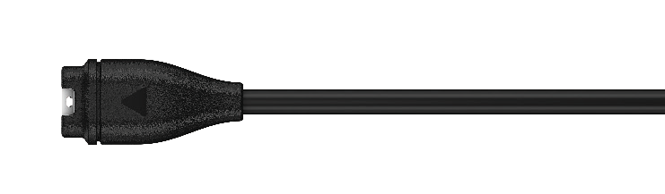
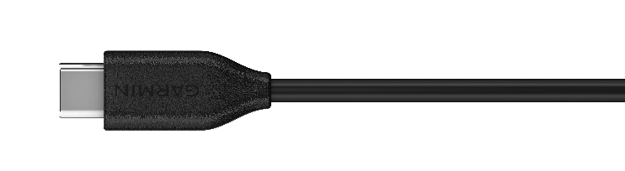
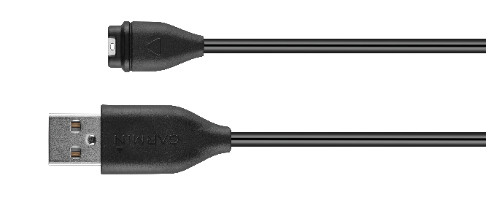
VENU® X1
PREMIUM GPS SMARTWATCH
NEW PRODUCT ANNOUNCEMENT
June 12, 2025
COMPATIBLE ACCESSORY OVERVIEW
DESCRIPTION | SKU | UPC | RRP | FITS WRIST | IMAGE
BLACK SILICONE BAND, 24 mm NEW | 010-13907-00 | 753759356774 | €39.99 | 135-210 mm
MOSS SILICONE BAND, 24 mm NEW | 010-13907-01 | 753759356781 | €39.99 | 135-210 mm
BLACK COMFORTFIT NYLON BAND, 24 mm NEW | 010-13907-02 | 753759356798 | €49.99 | 126-216 mm 160-250 mm
MOSS COMFORTFIT NYLON BAND, 24 mm NEW | 010-13907-03 | 753759356804 | €49.99 | 126-216 mm 160-250 mm
DESCRIPTION | SKU | UPC | RRP
USB-C® CABLE (0.5 M) USB-C® CABLE (1.0 M) | 010-13278-01 010-13278-00 | 753759340599 753759306014 | €24.99
USB-A CABLE (0.5 M) USB-A CABLE (1.0 M) | 010-12491-01 010-12983-00 | 753759176860 753759254445 | €24.99
For additional bands and compatible accessories, please visit Garmin.com.
¹See garmin.com/ataccuracy
² When paired with your smartphone
³This is not a medical device and is not intended for use in the diagnosis or monitoring of any medical condition; see Garmin.com/ataccuracy. Pulse Ox not available in all countries.
⁴When paired with your compatible smartphone; see Garmin.com/ble. For safety and tracking feature requirements and limitations, see Garmin.com/safety.
⁵See Garmin.com/GarminPay/Banks
⁶Requires both the sender and receiver of messages to have the Garmin Messenger app installed on their paired smartphones
iPhone is a trademark of Apple Inc., registered in the U.S. and other countries. Android is a trademark of Google LLC.

